Slide 1


Hotel Cancellation Analysis
This presentation delves into the exploratory data analysis (EDA) of hotel booking data, emphasizing the factors that affect cancellation rates. By examining various features, we aim to gain insights into customer behavior.

Slide 2

Key Features
Type of Meals
Number of Adults and Children
Room Types
Weekend and Week Nights
Lead Time
Car Parking Space
Market Segment Type
Date of Reservation
Special Requests

Slide 3




Influence of Meal Type and Parking on Guest Satisfaction
Understanding the impact of meal offerings and parking availability is essential for enhancing guest satisfaction. Providing value through meal plans and ensuring accessible parking can significantly reduce cancellation rates.
Type of Meal
Car Parking Space
Different meal plans (e.g., Meal Type 1) may influence guest satisfaction and their likelihood to cancel, as value perception plays a significant role in customer decisions.
Availability of parking can be a crucial factor for guests traveling by car; limited parking may lead to higher cancellation rates if guests perceive inconvenience.
1
2

Slide 4

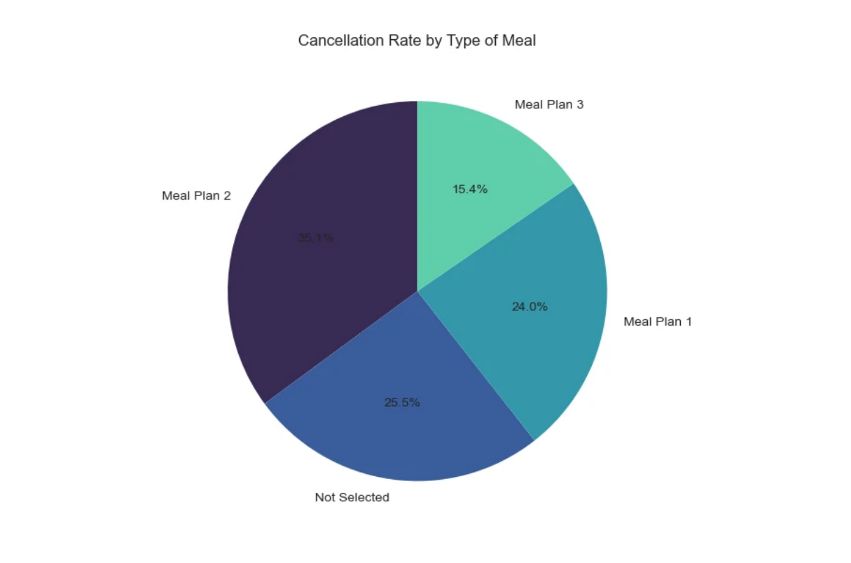
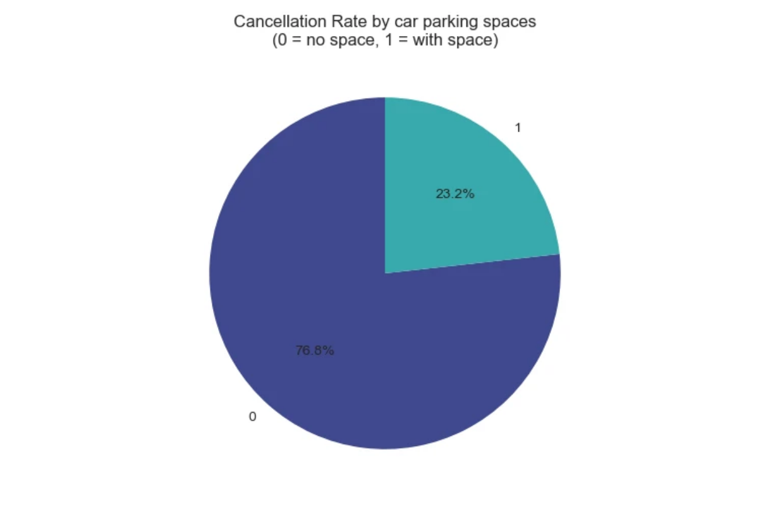
Influence of Meal Type and Parking on Guest Satisfaction
Meal Types
Car parking space
Meal Plan 2 has the highest cancellation rate with 35.1%
Customers without cars and no need for parking appear to have a higher tendency to cancel their bookings with a percentage of 76.8%

Slide 5



Impact of Room Types and Market Segment Types on Cancellation Behavior
Room Type
Higher Expectations
The type of accommodation can affect cancellation behavior.
Luxury options may lead to higher expectations and elevate cancellation risks.
Market Segment Types
Flexible Bookings
Different methods to book a room (e.g. online, offline, aviation, corporate, complementary).
Certain market segments, such as online, show higher cancellation rates due to flexible policies and less commitment.

Slide 6

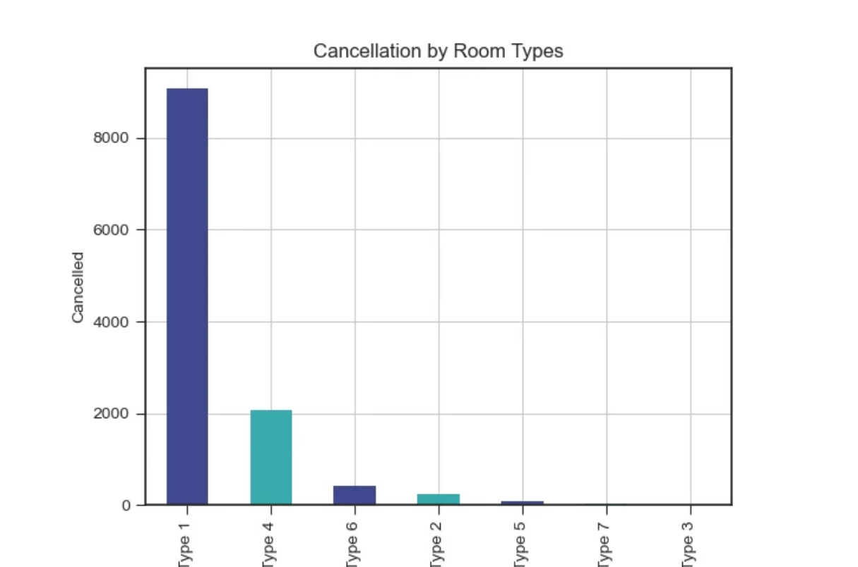
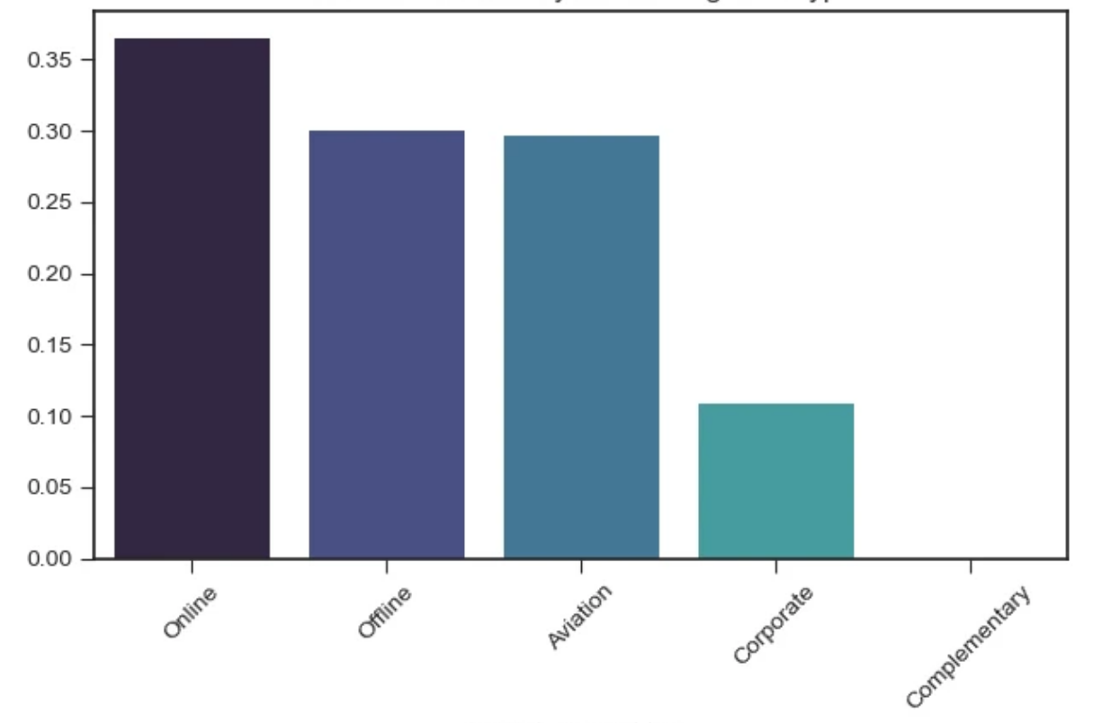
Impact of Room Types and Market Segment Types on Cancellation Behavior
Room Types
Market Segment Types
more than 9000 cancellations for Room Type 1 which represent 1/3 of whole data
Online Booking Method shows higher cancellation Rate rather than other segment types with >35%

Slide 7



Lead Time and Special Requests
Understanding the impact of lead time and special requests on guest behavior is crucial for improving booking stability. Proper handling of special requests can significantly lower cancellation rates.
Lead Time
Special Requests
The waiting time between reservation and arrival can significantly affect cancellation rates; higher time may deter cancellations.
Requests made during booking can indicate guest expectations, and failure to meet these may lead to cancellations.
1
2

Slide 8
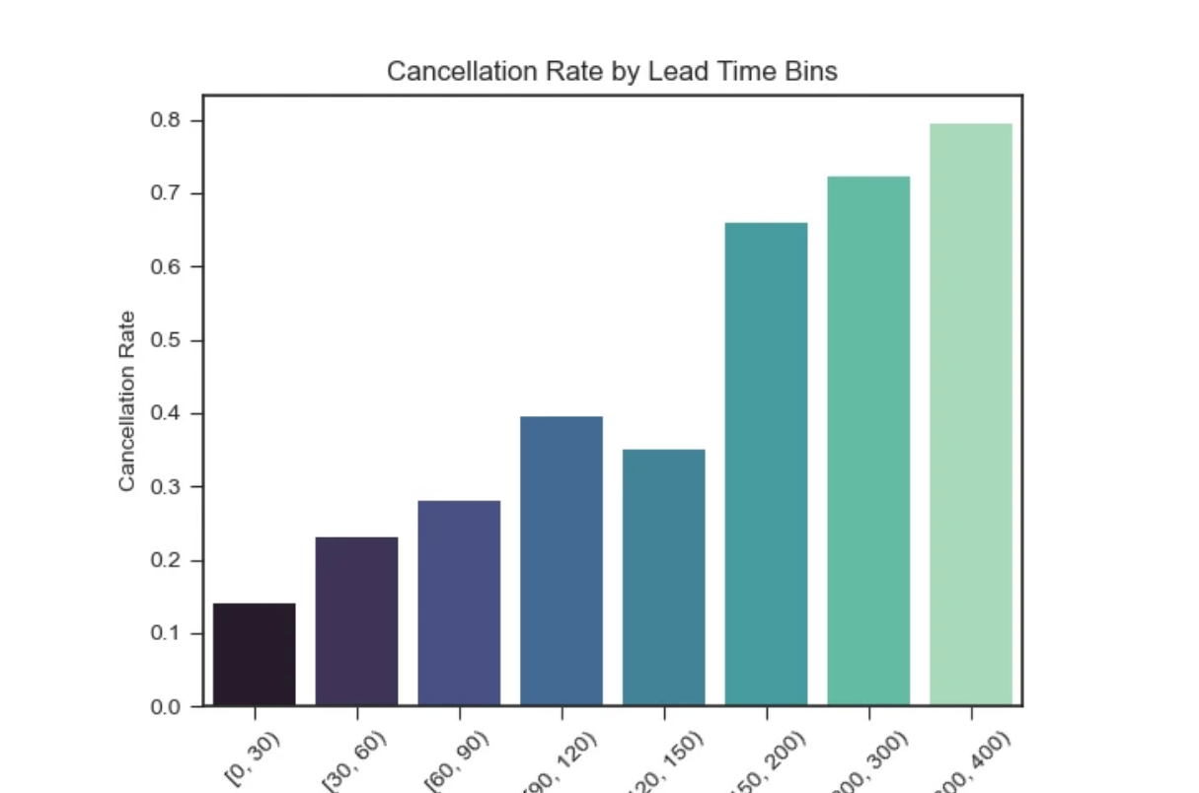
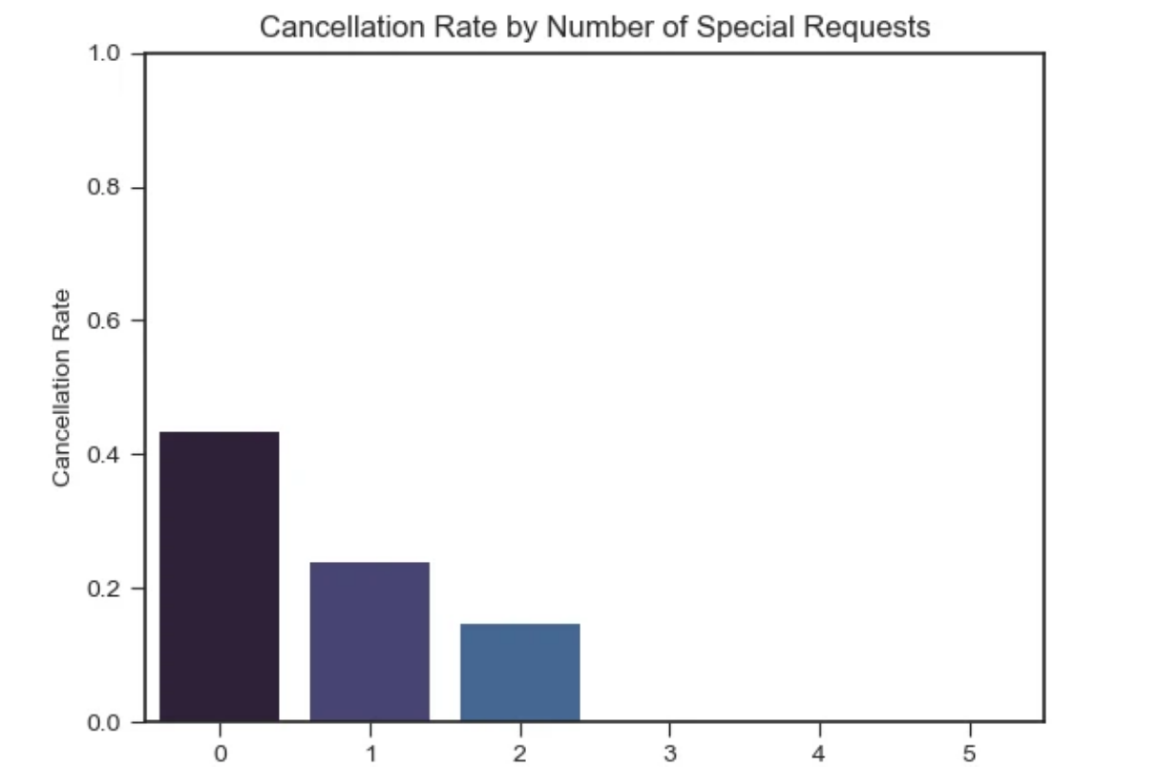
Lead Time and Special Requests
Lead Time
Special Requests
The more lead time consumed the higher tendency to cancel
people with no special requests have higher tendency to cancel with a percentage of 42%

Slide 9

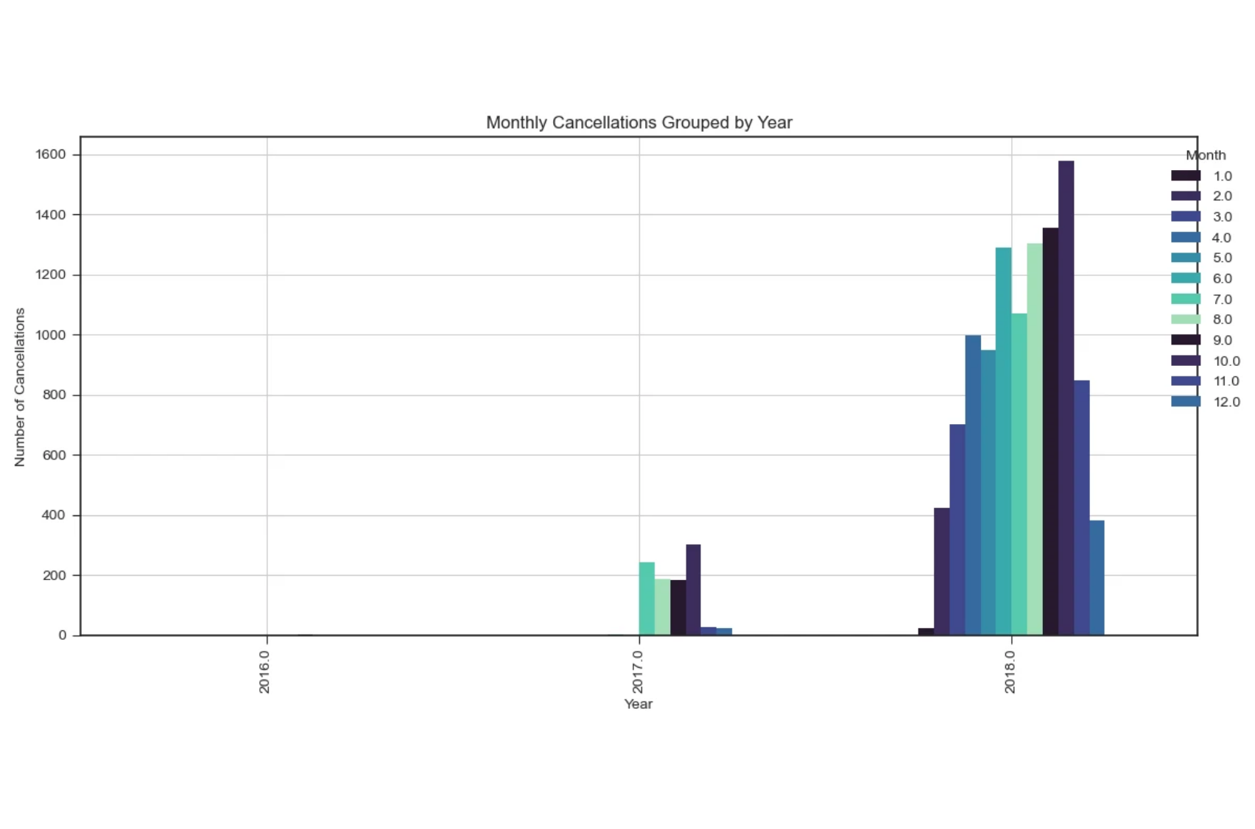
Cancellation by Reservation Dates
Reservation Dates by years and months
The graph shows that cancellations sharply increased in 2018, peaking between August and October, while 2017 had very few cancellations throughout the year

Slide 10
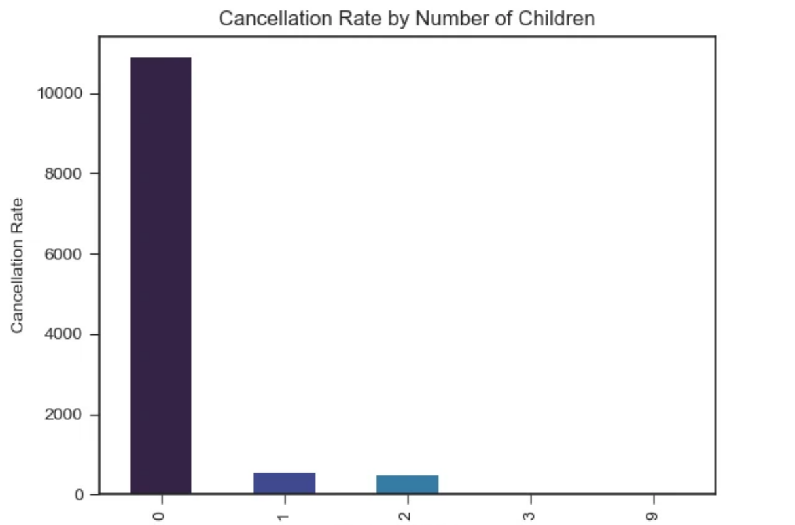
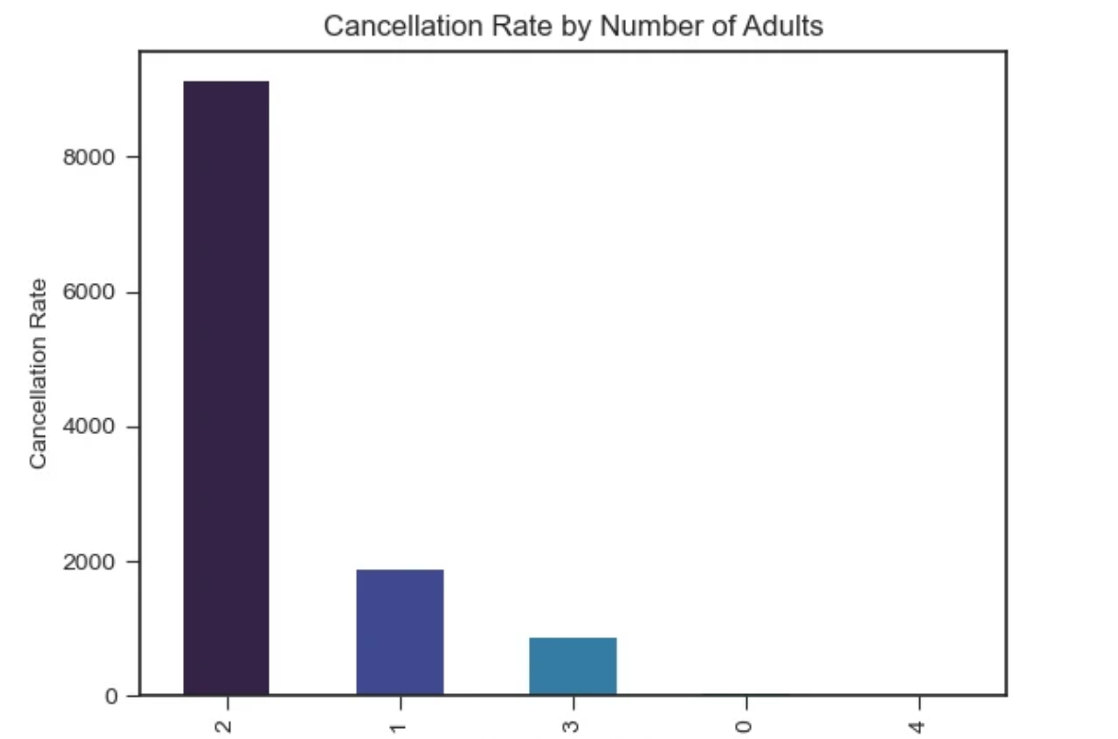
Number of Children and Adults Impact
Children Numbers
Adults Number
The more cancellation segments are with no children.
The more cancellation happens for
couples (adults = 2).

Slide 11
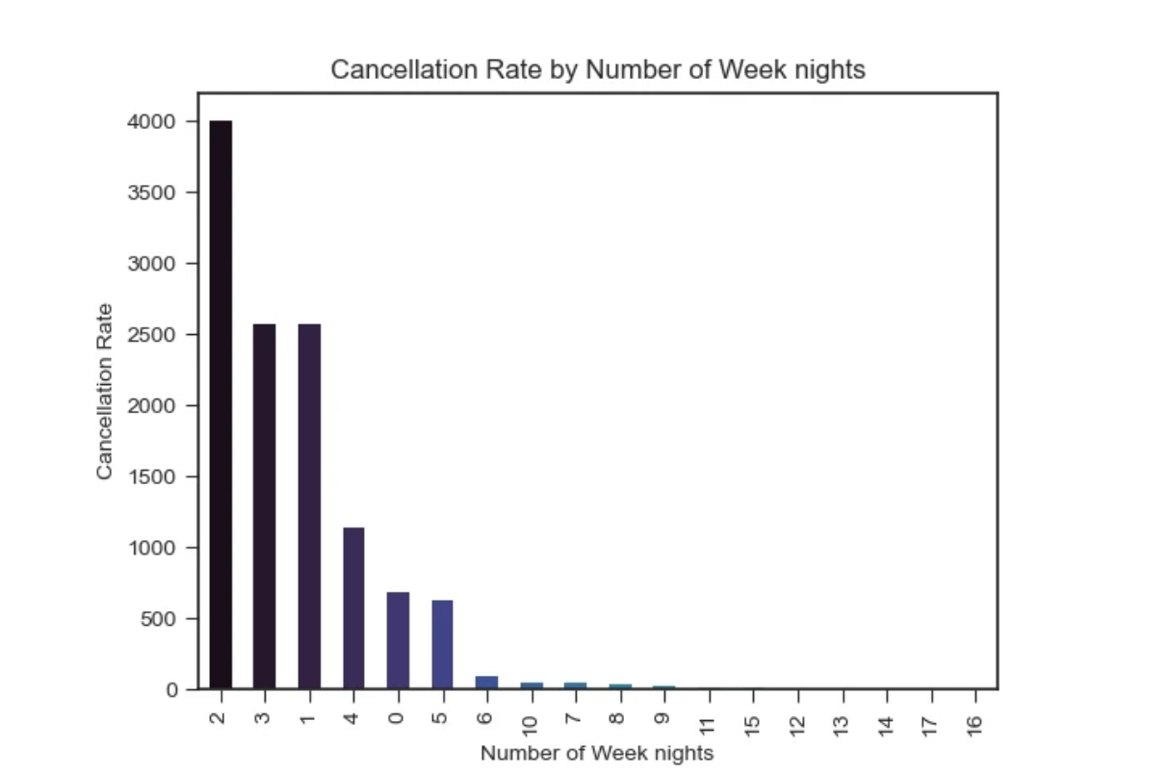
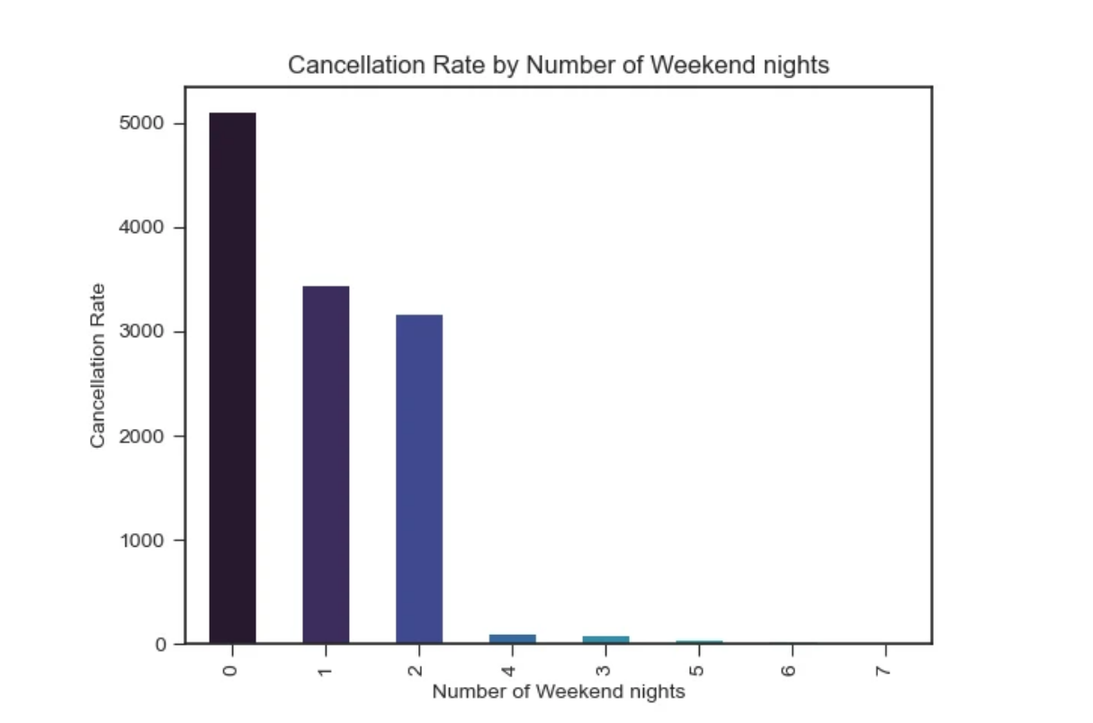
Number of Week and Weekend Nights
Week Nights
Weekend Nights
Majority of cancellation happens from booking for less than 3 weeknights.
Majority of cancellation happens from booking for less than 2 weekend nights.

Slide 12

Conclusion
Parking Influences Behavior
Guests without cars or parking needs tend to cancel more often.
Room Type Expectations
Luxury or specific room types experience more cancellations, possibly due to higher expectations.
Online Bookings Cancel More
Market segments like online bookings show the highest cancellation rates due to flexible policies.
Lead Time Correlates with Cancellations
Longer lead times are associated with higher cancellation likelihood — indicating impulsive bookings may be more stable.

Slide 13
Conclusion
Special Requests Reduce Cancellations
Guests who make special requests are less likely to cancel, signaling greater commitment.
Cancellation Peaks in Specific Months
2018 saw a sharp rise in cancellations, especially from August to October.
Families Cancel Less
Bookings with no children or exactly two adults (likely couples) cancel more frequently.
Short Stays Cancel More
Most cancellations occur for reservations with fewer than 3 weekday or weekend nights.

